Slide 1
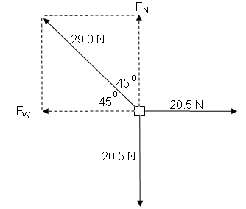
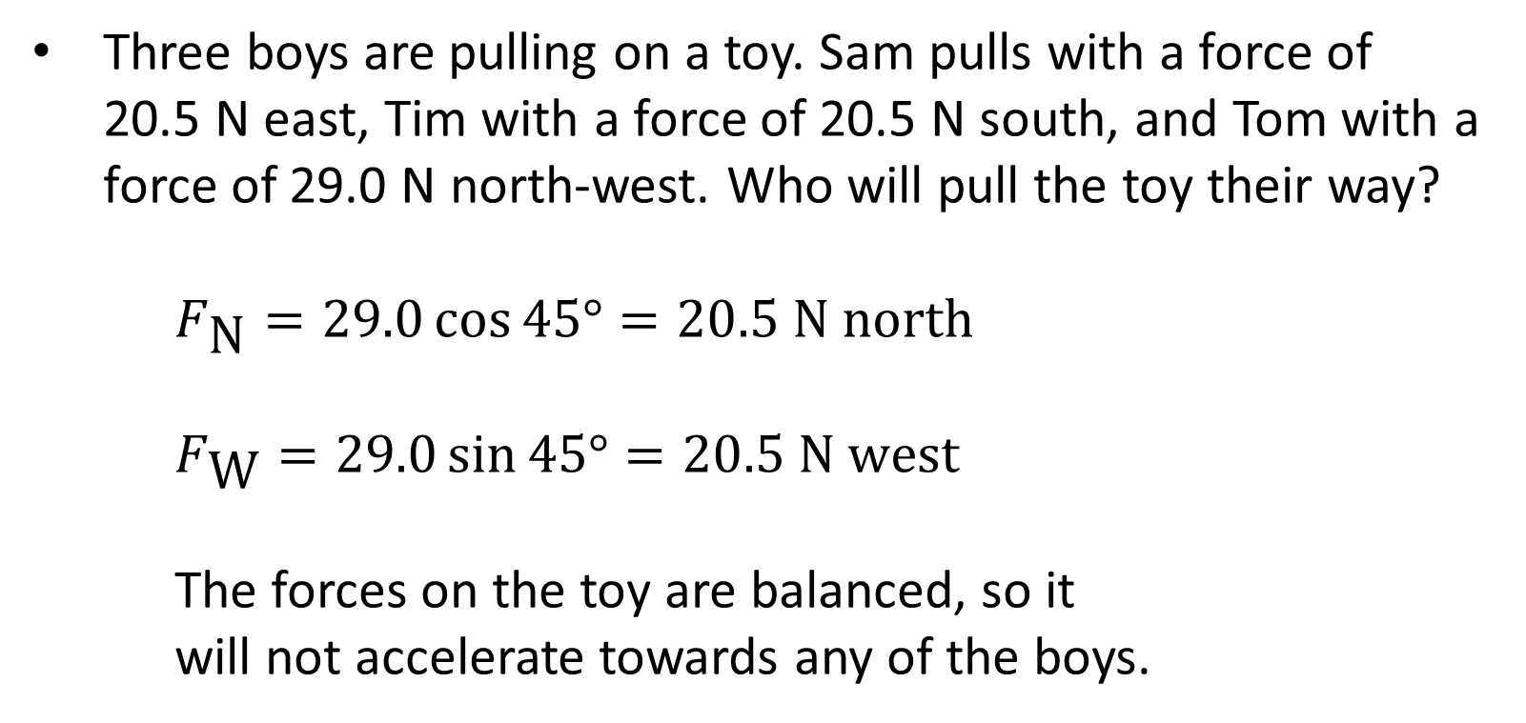
Vectors Review
Three boys are pulling on a toy. Sam pulls with a force of 20.5 N east, Tim with a force of 20.5 N south, and Tom with a force of 29.0 N north-west. Who will pull the toy their way?
$F_{\text{N}}=29.0\cos{45°}=20.5 \text{N} \text{north}$
$F_{\text{W}}=29.0\sin{45°}=20.5 \text{N} \text{west}$
The forces on the toy are balanced, so it will not accelerate towards any of the boys.

Slide 2
Forces on an Inclined Plane

Slide 3
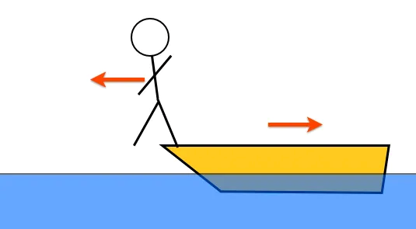
Newton’s Third Law
Newton's third law states that when a body exerts a force on another body (an action force) the second body exerts an equal force in the opposite direction on the first body (the reaction force).
Action-reaction pairs can never be added together, because they act on different bodies.
The forces in an action-reaction pair:
are the same magnitude
act in opposite directions
are exerted on two different objects

Slide 4
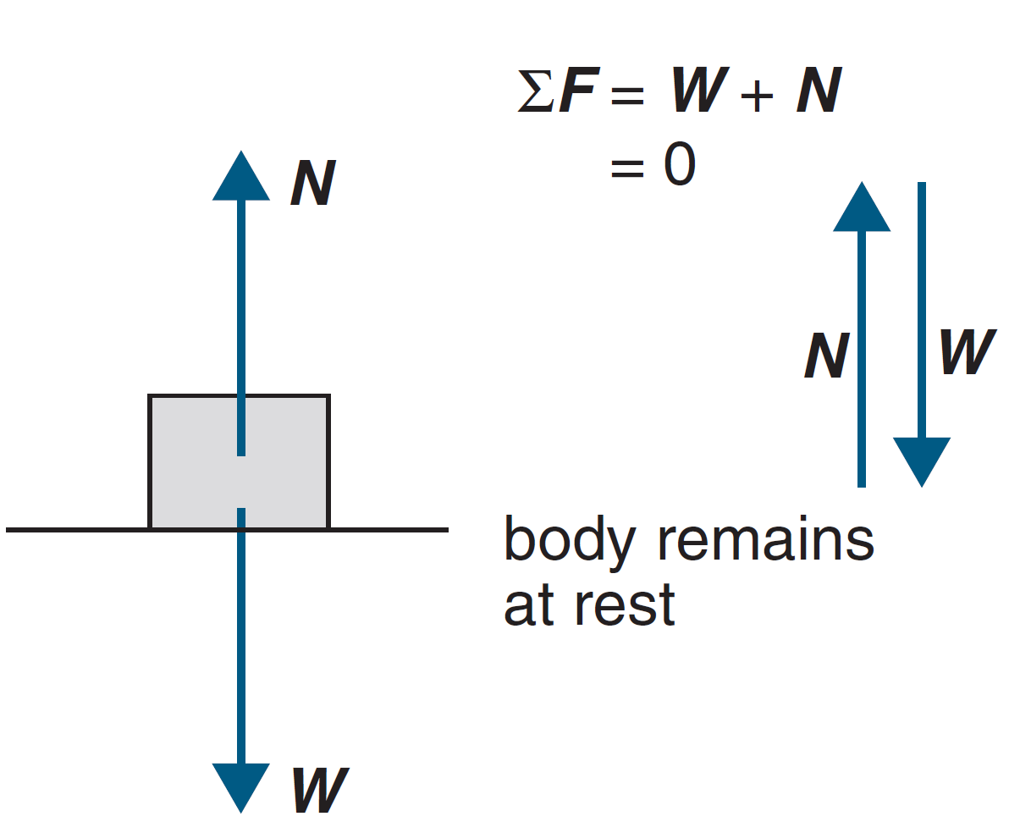
Normal Force: Plane Surface
When an object exerts a force on a surface, the surface exerts a reaction force on the object that is normal (at right angles) to the surface.
For an object placed on a flat surface, the normal force (N) is equal in magnitude and opposite in direction to the weight force (W).
So the net force is zero and the object does not accelerate.

Slide 5
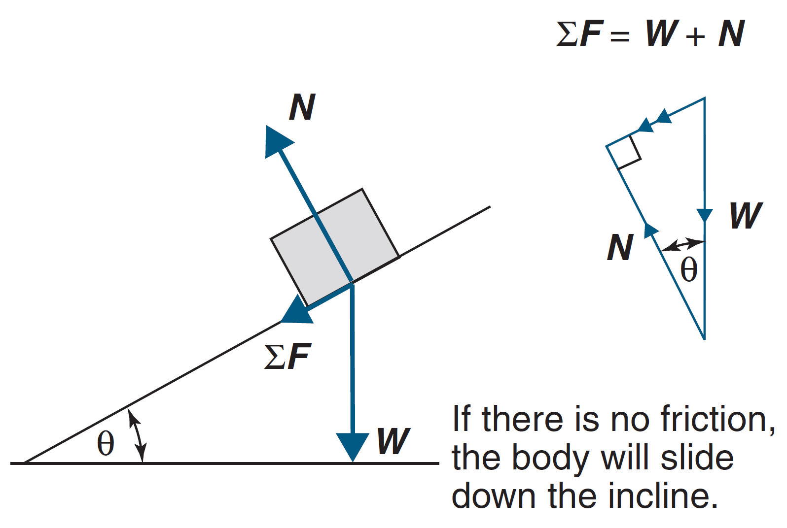
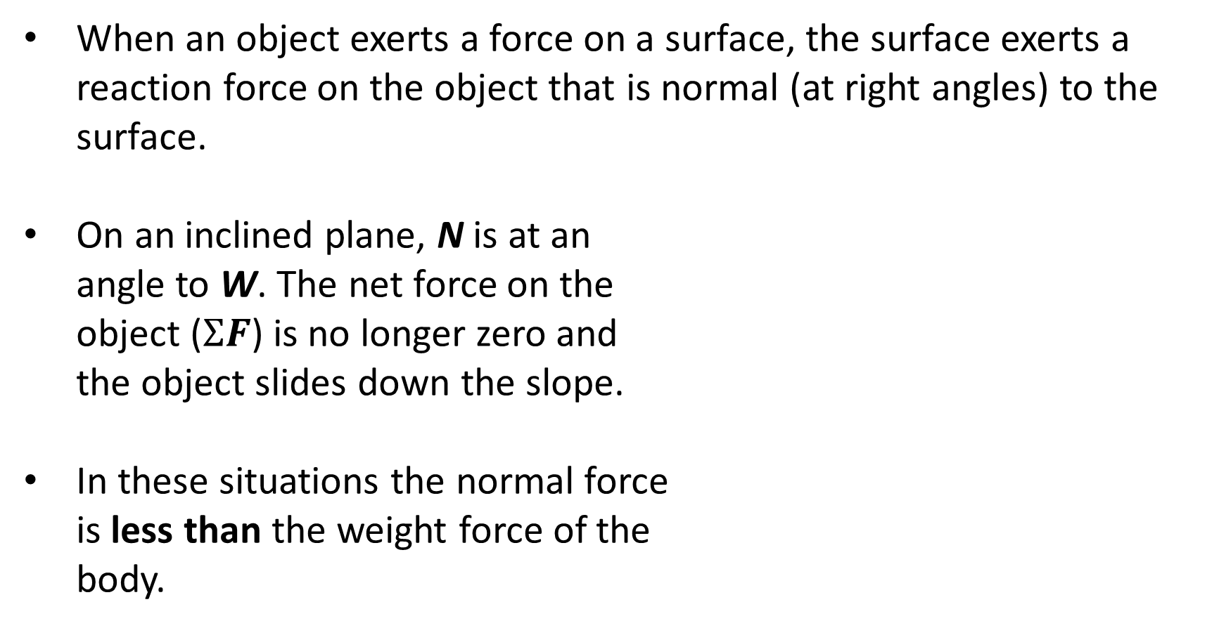
Normal Force: Inclined Surface
When an object exerts a force on a surface, the surface exerts a reaction force on the object that is normal (at right angles) to the surface.
On an inclined plane, N is at an angle to W. The net force on the object ($ΣF$) is no longer zero and the object slides down the slope.
In these situations the normal force is less than the weight force of the body.

Slide 6
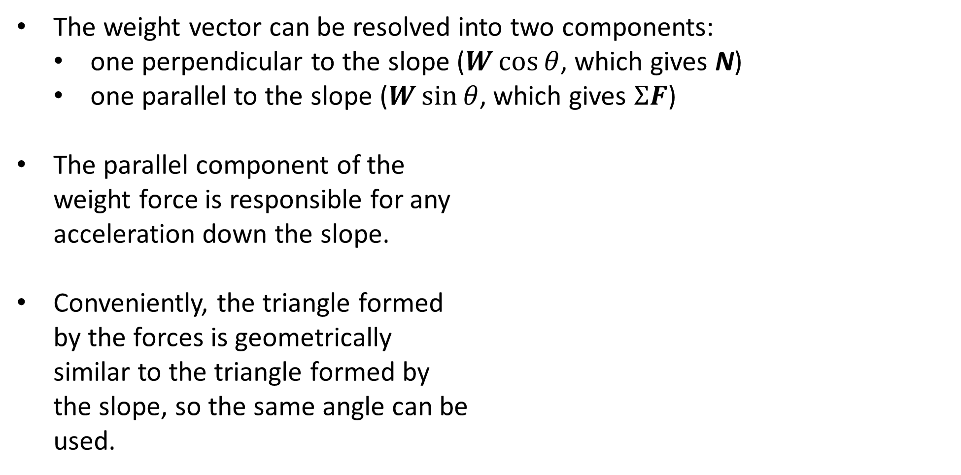
Normal Force: Inclined Surface
The weight vector can be resolved into two components:
one perpendicular to the slope ($W\cos{θ}$, which gives N)
one parallel to the slope ($W\sin{θ}$, which gives $ΣF$)
The parallel component of the weight force is responsible for any acceleration down the slope.
Conveniently, the triangle formed by the forces is geometrically similar to the triangle formed by the slope, so the same angle can be used.

Slide 7
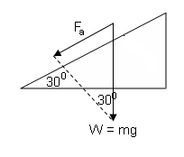
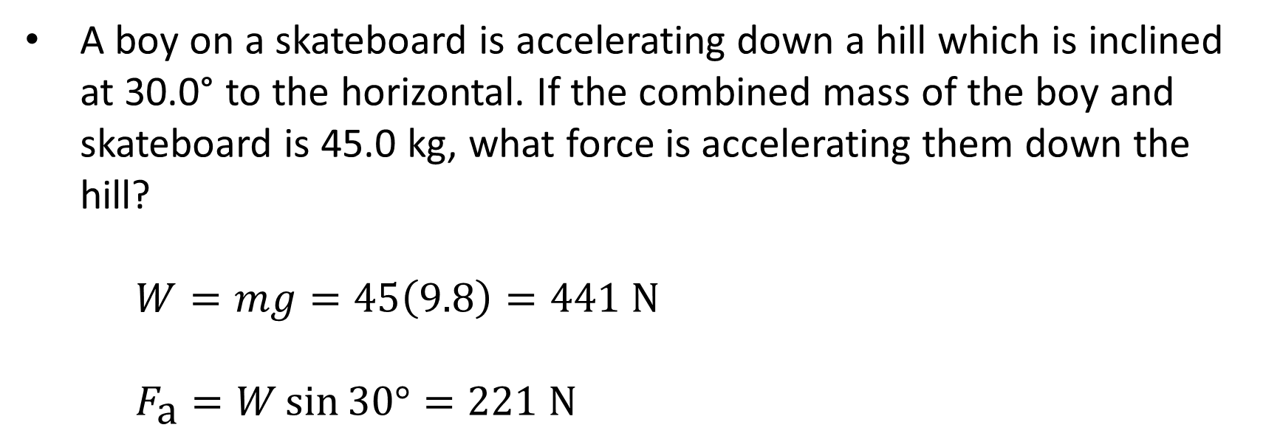
Example #1
A boy on a skateboard is accelerating down a hill which is inclined at 30.0° to the horizontal. If the combined mass of the boy and skateboard is 45.0 kg, what force is accelerating them down the hill?
$W=mg=45\left(9.8\right)=441 \text{N}$
$F_{\text{a}}=W\sin{30°}=221 \text{N}$

Slide 8
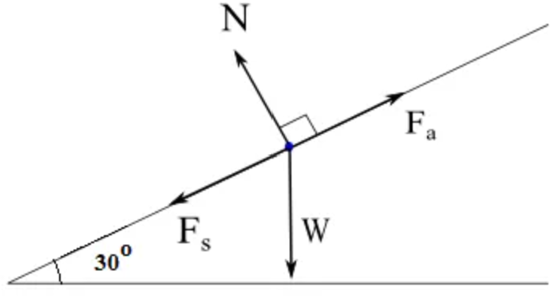
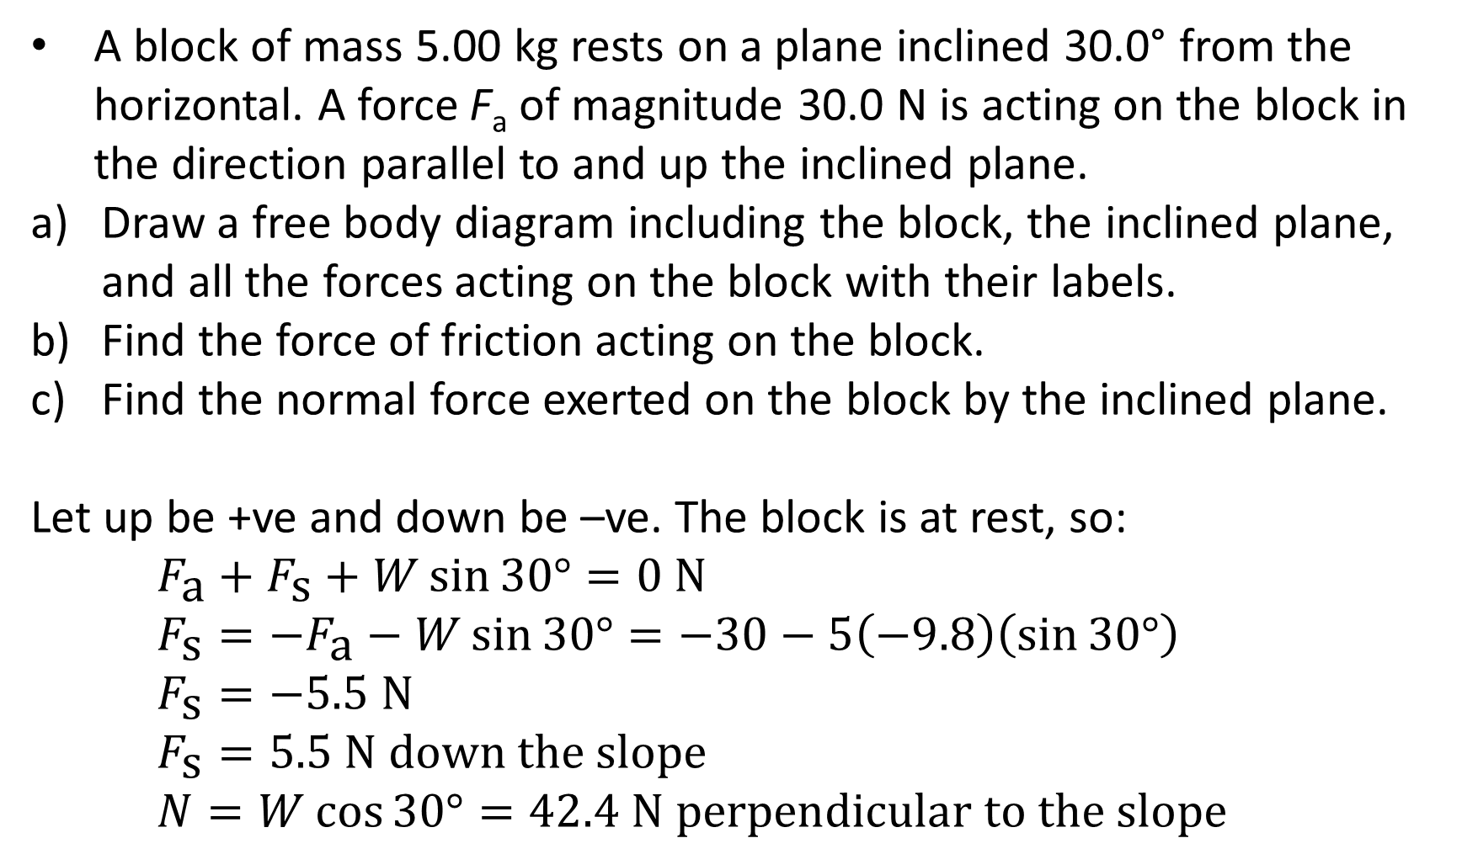
Example #2
A block of mass 5.00 kg rests on a plane inclined 30.0° from the horizontal. A force F_{a} of magnitude 30.0 N is acting on the block in the direction parallel to and up the inclined plane.
Draw a free body diagram including the block, the inclined plane, and all the forces acting on the block with their labels.
Find the force of friction acting on the block.
Find the normal force exerted on the block by the inclined plane.
Let up be +ve and down be –ve. The block is at rest, so:
$F_{\text{a}}+F_{\text{s}}+W\sin{30°}=0 \text{N}$
$F_{\text{s}}=−F_{\text{a}}−W\sin{30°}=−30−5\left(−9.8\right)\left(\sin{30°}\right)$
$F_{\text{s}}=−5.5 \text{N}$
$F_{\text{s}}=5.5 \text{N} \text{down} \text{the} \text{slope}$
$N=W\cos{30°}=42.4 \text{N} \text{perpendicular} \text{to} \text{the} \text{slope}$

